Slide 1
Service Call Reporting Guide
Notes:
Read Slide.

Slide 2
Facilities Service Request Page
The Facilities Services Division Service Request page is used to report equipment maintenance and pest control issues. Some examples include:
Refrigeration repair
Oven calibration
Chipping paint
Pest activity
This DOES NOT include computer issues; follow instructions: How To Create a Remedy Ticket for computer issues.
Notes:
Read Slide.

Slide 3
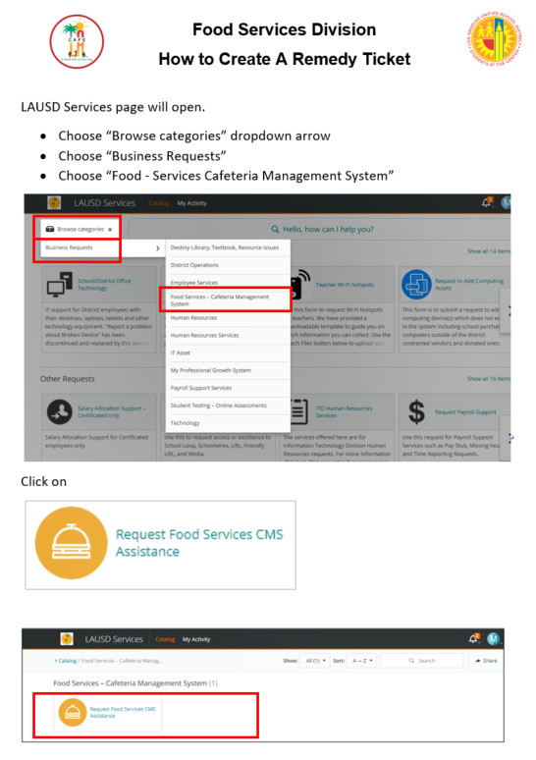
Remedy Service Ticket
The Remedy Service Request page is used to report computer software and hardware issues.
Instructions are available on the Café LA website, Training and Resources page, in the CMS section.
Notes:
Read Slide.

Slide 4
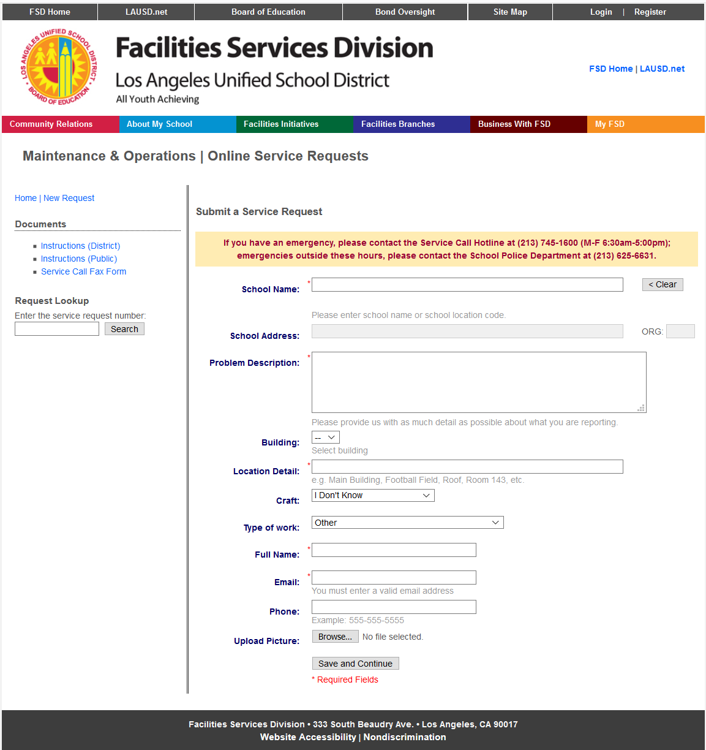
Managers can access the Facilities Services Division Service Request page through the following URL:
http://mo.laschools.org/applications/mo/workorder-request/
Notes:
Read Slide.

Slide 5
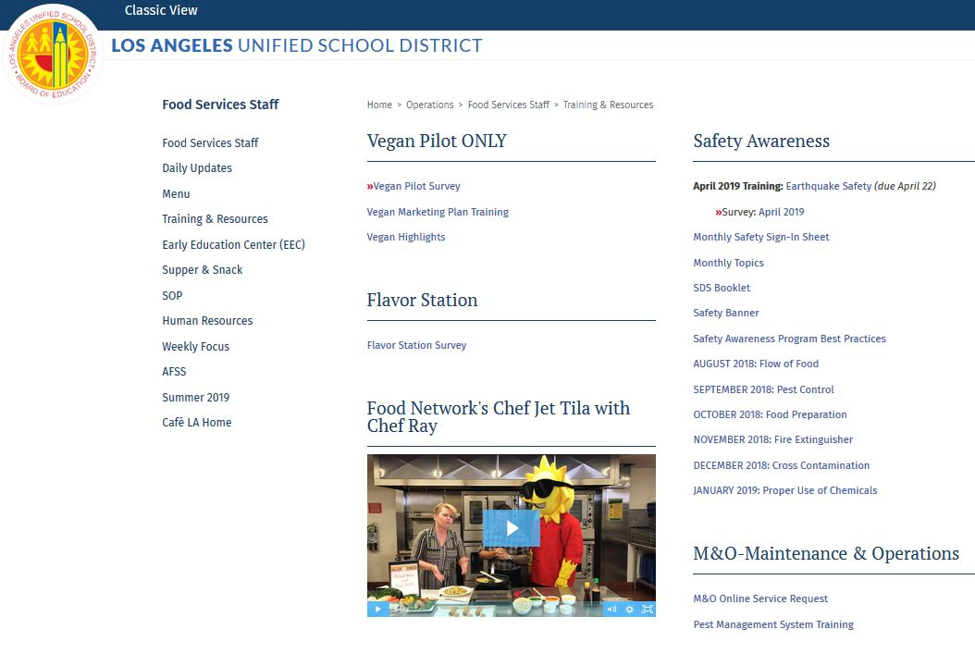
To access the Facilites Services Division Service Request page from the Café LA website , go to the Training & Resources page.
From M&O Maintenance & Operations
Click on:
M & O Online Service Request
Notes:
READ:

Slide 6
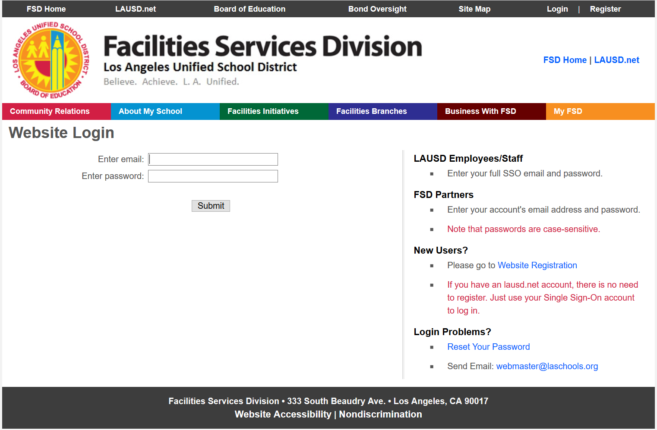
Login
Click the Login link on top right hand corner of page.
Enter your full district email address and password.
Notes:
Read Slide.

Slide 7
Service Request Homepage
After login, you will be taken to the Facilities Services Division homepage.
Your name will appear in top right corner
“Logged in as (YOUR NAME HERE)”
Notes:
Read Slide.
Emergency contact is listed on this homepage. After emergency phone call, you will still need to submit a service request.

Slide 8
M&O Login Troubleshooting
If permission is denied, contact your Staff Aide to request assistance with access to online service requests.
East & West LD
Lisa Hess
lisa.hess@lausd.net
Central & South LD
Kevin Ramos Paz
Kevin.ramospaz@lausd.net
Northeast LD
Michael Lewis michael.l.lewis@lausd.net
Northwest LD
Abyz Dayrit
abyz.dayrit@lausd.net
Notes:
READ:

Slide 9
Initiate New Service Request
Enter the School Name or Location Code of where the issue resides.
A drop down list of sites matching your entry will appear; select the appropriate record.
*If you entered or selected the wrong value, you may reset the field by clicking on the Clear button.
Notes:
Read Slide.

Slide 10
School Name and Address
After selecting the appropriate site, the School Address and Location Code will auto populate.
Notes:
Read Slide.

Slide 11
Problem Description
In as much detail as possible include:
Location of item
Board Number (if available)
Item problem
Notes:
Read Slide.

Slide 12
Fill Remaining Fields
Building
Location Detail
Craft
Type of Work
*Use the dropdown arrows to make selections.
Notes:
Read Slide.

Slide 13
Fill Remaining Fields
Full Name
Phone
Upload Picture
*Your name will auto-fill after signing in
Notes:
Read Slide.

Slide 14
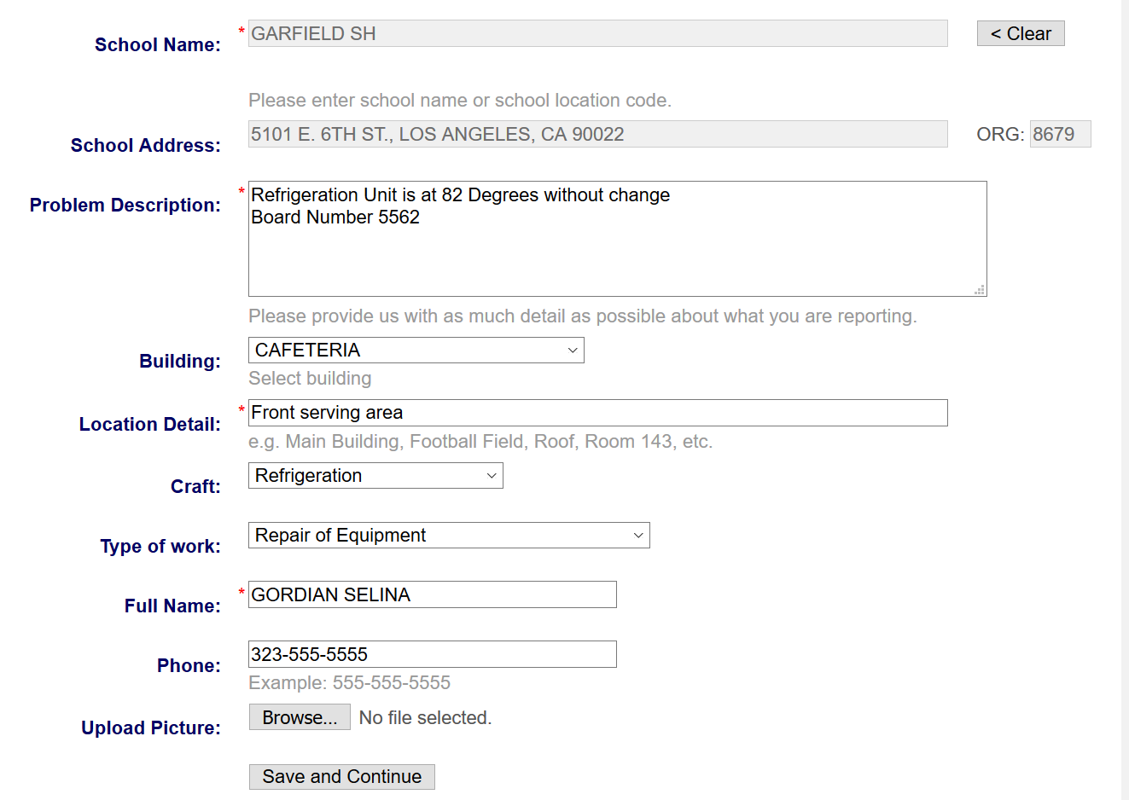
Save and Continue
Ensure all fields are completed
Click “Save and Continue” at bottom of screen
Notes:
Read Slide.

Slide 15
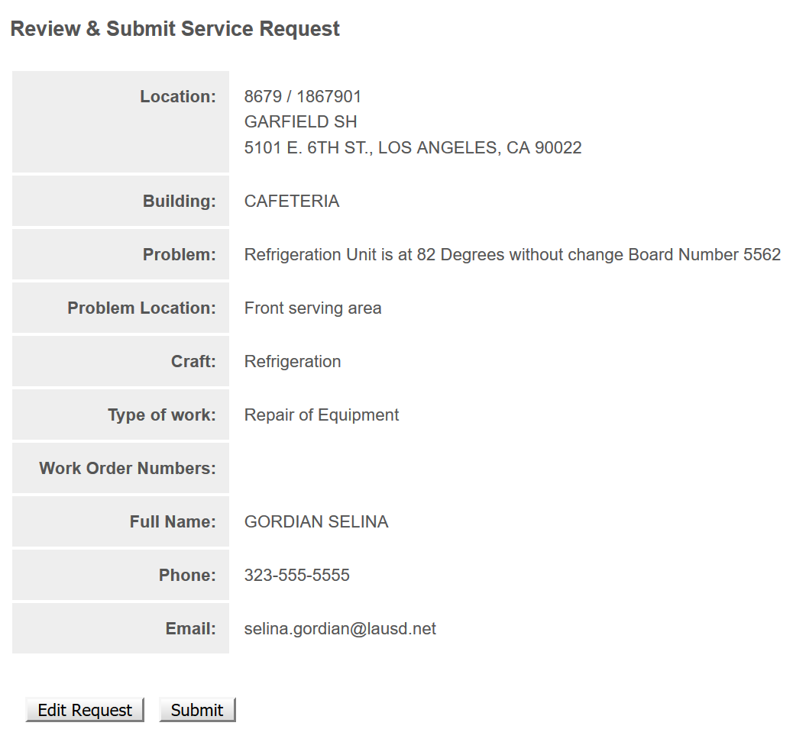
Review and Submit Request
You will be able to review the service request and make changes if necessary.
Click “Submit”, if you need to make changes select “Edit Request” to go back to the previous page.
Notes:
Read Slide.

Slide 16
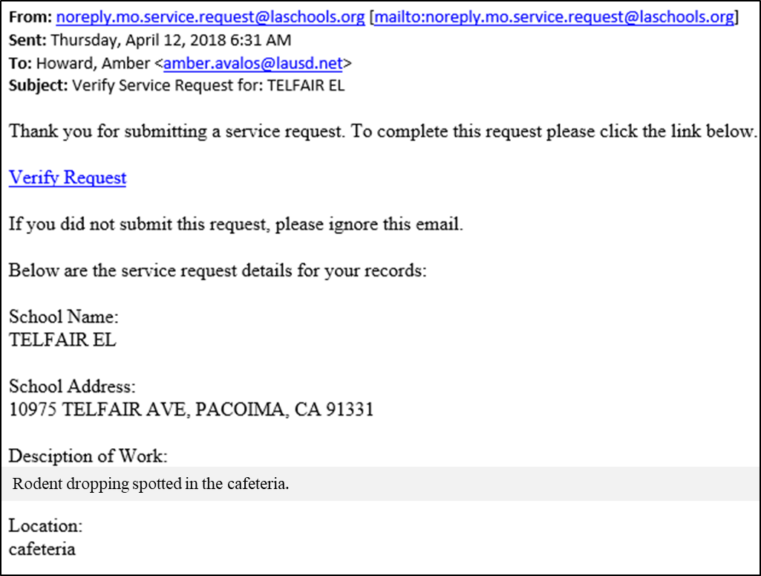
1st Email - Report Verification
The M & O verification process is completed in two emails.
Verify Request
Report Validation
1st email:
Click on “Verify Request” to complete the request.
Notes:
Read Slide.

Slide 17
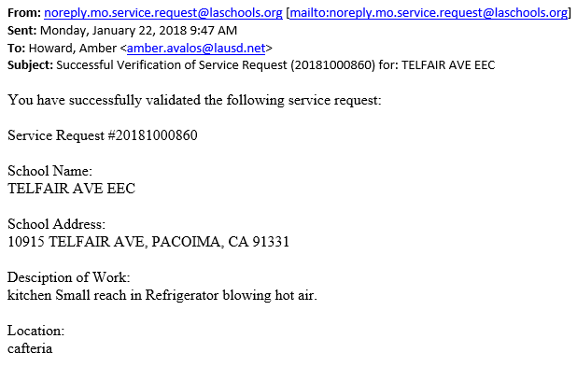
2nd Email - Report Validation
2nd email:
Confirms the successful validation of the request and provides a service request number.
Rodent dropping spotted in cafeteria.
Notes:
Read Slide.

Slide 18
Service Call Requests Page
All requests will be displayed on the Service Call Requests page. Displayed is a list of call(s) that you have generated from this webpage.
To view additional details of the call, you may click on the Request Number.
Notes:
Read Slide.

Slide 19
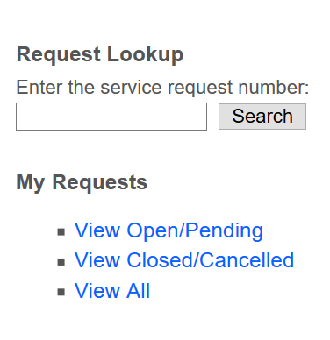
Review Pending Requests
To review a pending request with the request number, use the search box on the left of the Facilities Services Division website page.
Notes:
Read Slide.

